Slide 2
Stacks and Queues - Intro
In this module
Stacks
What it is
How it works
How it’s designed
What its used for
Queues
What it is
How it works
How it’s designed
What it’s used for

Slide 3
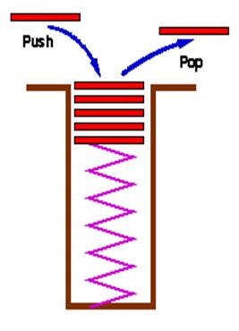
Stack
Last in, First out (or First in, Last out) FILO or LIFO
The last item inserted is the first removed
Accessor functions are usually “push,” “pop” and “top”
Supplemental functions
Clear
isEmpty
size
Notes:
Image taken from http://sourcecodemania.com/wp-content/uploads/2012/02/stack-example.jpg

Slide 4
Stack, how it works
Push simply adds to the front
Pop simply removes from the front
Supplemental functions need to be provided as well as Big 3, if applicable

Slide 5
Stack storage
Comparison of storage methods
 | List | Array
push | O(1) | O(1)/O(N)
pop | O(1) | O(1)
top | O(1) | O(1)
clear | O(N) | O(1)
isEmpty | O(1) | O(1)
size | O(1) | O(1)

Slide 6
Stack Storage -Continued
Since we recognize that pop will happen more often than clear, the list makes considerably more sense to use than the array.
We will use the built-in STL list class.
Push will call push_front
Pop will call pop_front
Other functions will be mapped to equivalent STL functions

Slide 7
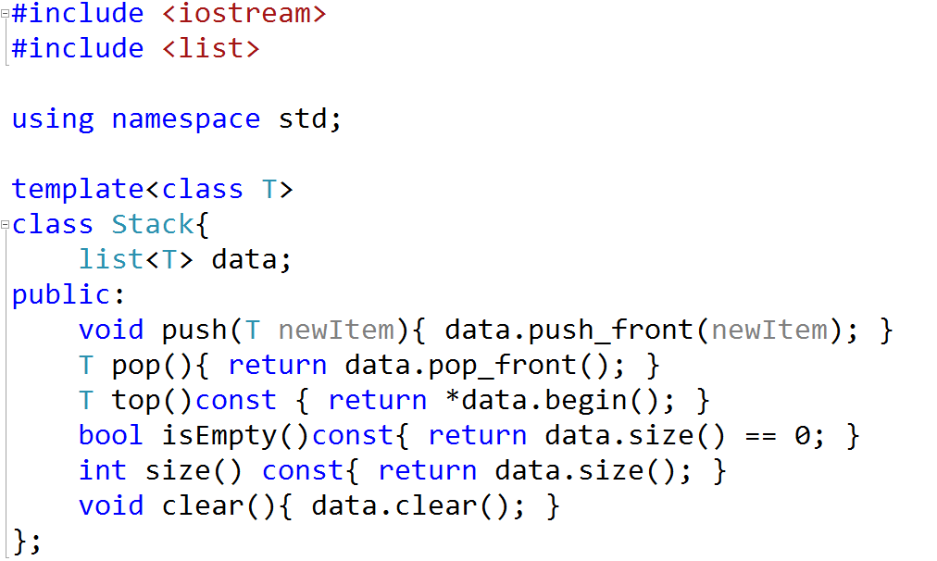
Stack Code

Slide 8
Stack, what is it used for
Compilers
Used for pattern matching, ({[ matches ]})
When an open is encountered, it is pushed
When a close is encountered, it is compared to the open at the top and, if a match, the top is popped.
(animate next slide, if possible)
Math Infix to post-fix conversion
Math post-fix to value evaluation

Slide 9
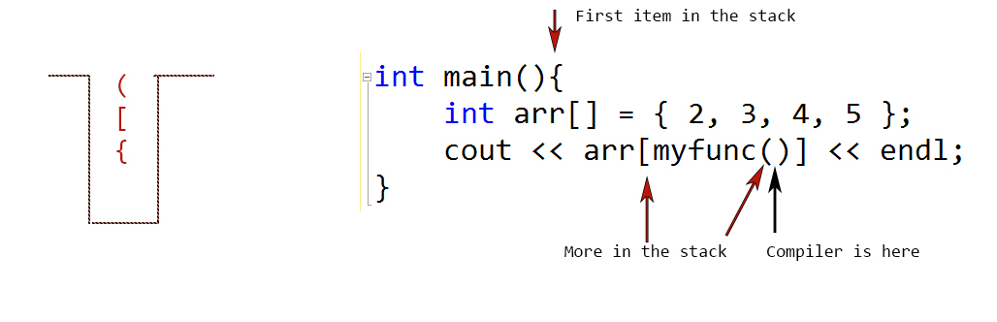

Slide 10
Order of insertions
push(‘(‘) – stack now: (
top – compares ‘(‘ to ‘)’
pop – stack now: (empty)
push(‘{‘) – stack now: {
push(‘[‘) – stack now: {[
top – compares ‘[‘ to ‘]’
pop – stack now: {
push(‘{‘) stack now: {{
top – compares ‘{‘ to ‘}’
pop – stack now: {
push(‘[‘) – stack now: {[
push(‘(‘) – stack now: {[( - this is the image I show
top – compares ‘(‘ to ‘)’

Slide 11
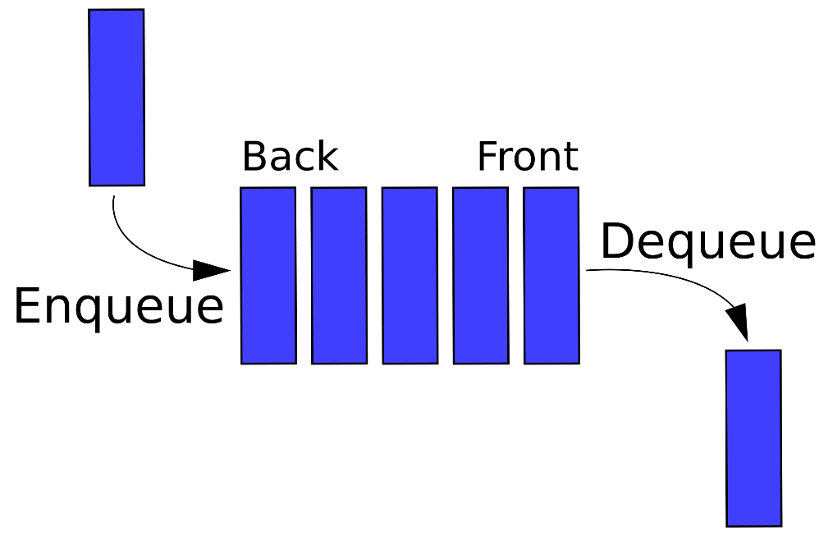
Queue, what is it
First in, first out (FIFO) data structure
The first item which is enqueued if the first item dequed
Often used for buffering information
Push, pop and top are often the accessor functions, however it may be enqueue, dequeue and top.
Supplemental functions
clear
isEmpty
size
Notes:
Image taken from: https://upload.wikimedia.org/wikipedia/commons/thumb/5/52/Data_Queue.svg/2000px-Data_Queue.svg.png

Slide 12
Queue, how it works
Enqueue adds to the end
Dequeue removes from the front
Could also be vice-versa
Supplemental functions need to be provided as well as Big 3, if applicable

Slide 13
Queue Storage
 | List | Array
push | O(1) | O(1)/O(N)
pop | O(1) | O(N)
top | O(1) | O(1)
clear | O(N) | O(1)
isEmpty | O(1) | O(1)
size | O(1) | O(1)

Slide 14
Queue -Continued
Much more obvious that we will use a List
Similar implementation to the stack with minor changes
Enqueue will add to the end of the queue
Dequeue will remove from the front
Necessary to make sure the list has both head and tail pointers.

Slide 15
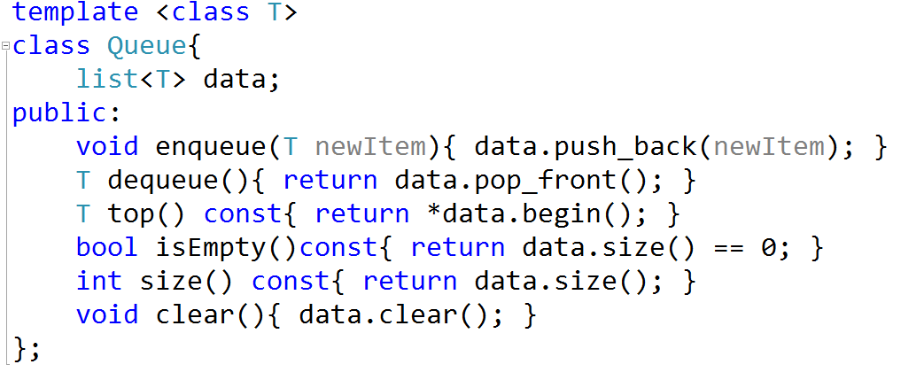
Queue Code

Slide 16
Queue, what is it used for
Storage Buffers
Anywhere that we need an ordered list with First in, First out properties

Slide 17
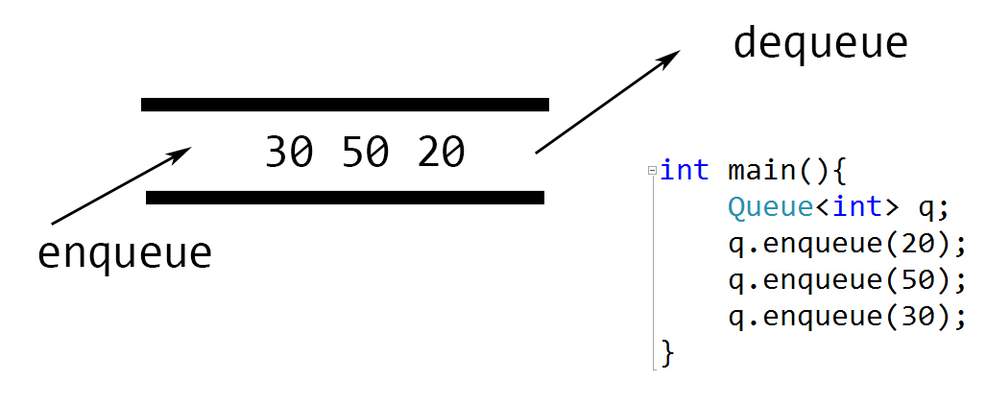
Queue image (animate????)

Slide 18
Stacks and Queues - Conclusion
What we learned
Stacks
How they work
How they are implemented
What they are used for
Queues
How they work
How they are implemented
What they are used for

